Slide 1

Forsideslide

Slide 2

@bjartnes #cxlambda
Notes:
Bjørn Einar Bjartnes. Principal engineer with Computas, an IT solutions provider. We provide services and solutions for business processes and collaboration. My current role is technical lead in a traditional .NET web project with Web API 2, SQL Server, Entity Framwork etc… .NET the good parts. We even recently plugged a tiny bit of F# in there, so I’m a happy man these days.
Also, I spend a lot of time tinkering around with fun stuff, that might be Code Clubs (as I did a few days ago here at NDC), robots such as the AR Drone or my new little humanoid robot or just chilling in the Computas lambda club. The humanoid is the greatest little thing, my daughter’s little brother. Also, I spend some time tinkering about with the internet of things.

Slide 3

LAYERS

Slide 4
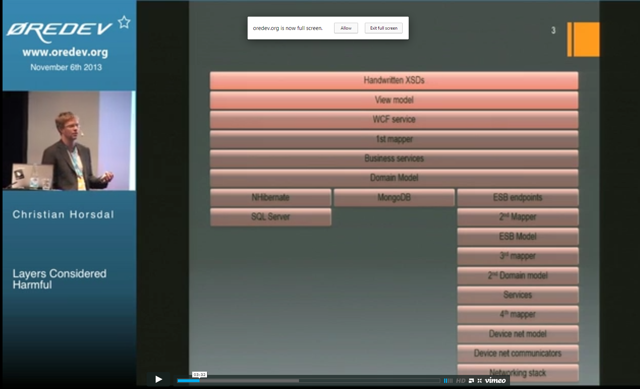
Layers in general...
Notes:
Today I want to talk about reducing layering. “Layers considered harmul” was an interesting talk by Christian Horsdal (http://oredev.org/2013/wed-fri-conference/layers-considered-harmful) at Øredev. I am restricting myself to the same types of systems he is talking about, traditional enterprise software, not games or OS’es or whatever. It might apply there as well, but I wouldn’t really know. And I think they do it. I am actually only showing of webstuff. And databases. And middleware. That is – typical .NET/Web projects. Like I do. That’s probably why.

Slide 5

Streams
Notes:
How I learned to stop worrying and love the stream.

Slide 6
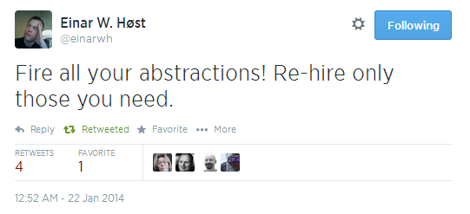
Fire your abstractions

Slide 7
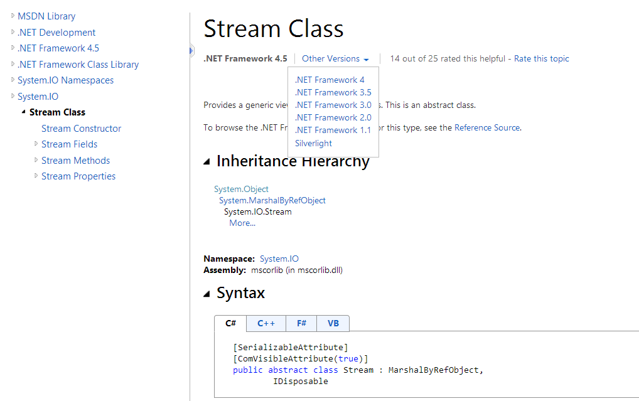
Stream class
Notes:
Talk is part rant, part intro to .NET streams and part practical examples where I’ve used streams. If you do know about .NET streams, maybe you can nod along to rants about layers and hopefully towards the end you can see some examples that are a bit less toy/intro examples on how to do it. I am not going to talk about Streaming architectures in general, there are things like Rx, TPL Dataflow, Streams insight, Complex event processing. I am restricting myself to System.IO.Stream only. Layer zero. Byte[]. Unsigned integers. 0 to 255. Like the C64. 8-bit. It might be considered a bit programming by hyperbole, I’m overrestricing myself in one way if you want to think of general patterns that are sufficently powerful to fit all aspects of a project, which is ok to have in the back of your head. If you need more abstractions than 0, then know that there are things like TPL dataflow and Rx and Streams insight, websockets and things that might fit well with the same style of thinking.
- Playing led me to think in streams, look for them. And I found a few.
Christian in his talk on layered considered harmful are talking about changing, how many layers you must change etc. Also his solutions are more general on how to attack general problems. That is one aspect. The main concern I am going to talk about is memory use and latency. There are many other aspects as well. I’m not about general concerns right now.

Slide 8
Some demos
Read from file without filestream
Read from the internet without filestream
Read from the internet with streams
non-streaming server
dev/null
more dev/null
Notes:
Nonstreaming stuff. Blocking.
If you don’t stream you block.
2. Sync lese og sync lese fra internet
2.5 stream til console
4. Devnull
5. Linux til Devnull

Slide 9
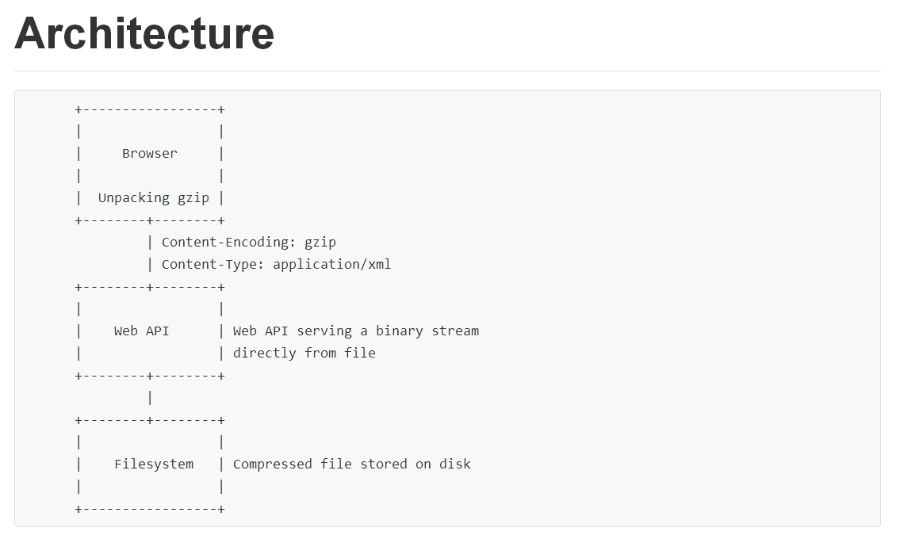
Architetcure of simple streaming from filesssytem
Notes:
Demo 6

Slide 10

NODE JS, shared writable state og concurrency…
Notes:
Demo 7, sammenligne node og system.io.stream
Vise at om man bare leser eller bare skriver en vei er det noe som blir litt lettere, i det minste…
You ned Joe Albahari and a time-machine.

Slide 11
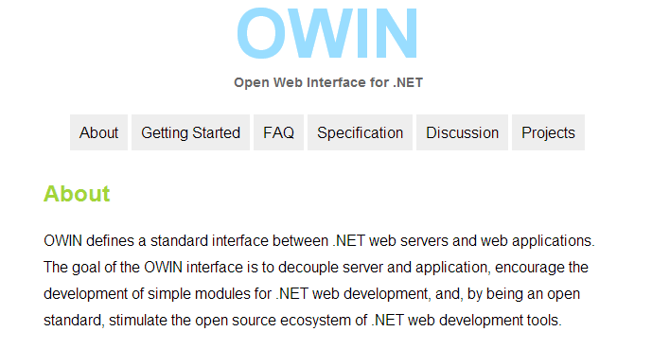
OWIN
Notes:
8. AllCaps Server

Slide 12

MONGODB
Notes:
Time for databases. We can’t stream from the filesystem.

Slide 13


SQL SERVER

Slide 14
SQL Server streaming
SQL Server FileStream
Handles to underlying file
varbinary(max)
SQL Server
GetStream Retrieves binary, image, varbinary, UDT, and variant data types as a Stream
Notes:
(There are other databases that let’s you stream resultsets, but this is just the basic stuff we already have)
We are holding connections open here…

Slide 15
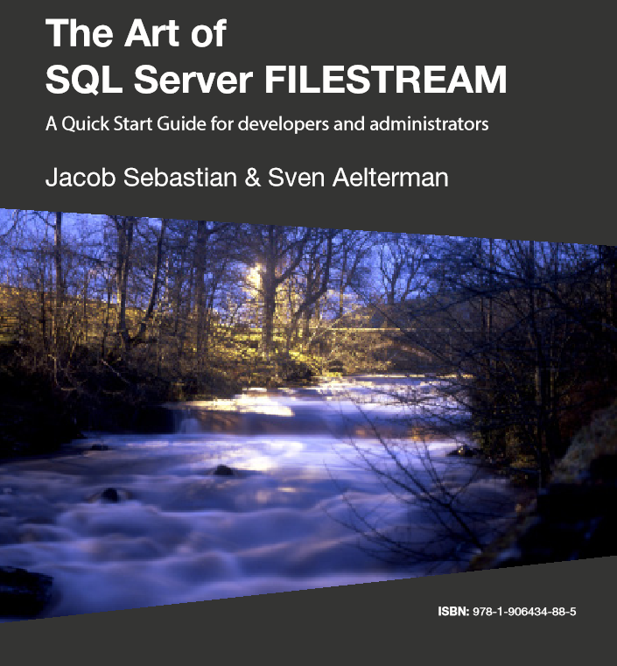
SQL SERVER FILESTREAM BOOK
Notes:
SQL Server FileStream, never used in practice. Is mostly about internal storage, but it requires stuff to change on the database setup… And in the Enterprise can be harder.

Slide 16
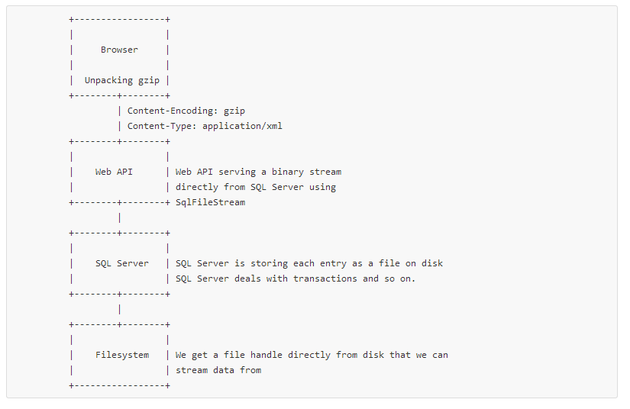
FILESTREAM ARCHITECTURE

Slide 17
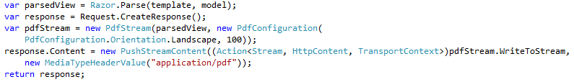
PushStreams in Web API
Notes:
Actually not a stream, it writes to a stream… SO you can make content that will be written to later…

Slide 18

DIY STREAMS
Notes:
Vi kan lage strøm fra databasen, gjennom web api, gjennom OWIN middleware, gjennom internettene, til klienten, gjennom gzip unzipper til browseren og streaming xml-parsere...

Slide 19
More streams…?
All content
https://github.com/bjartwolf/ndcoslo2014
Better documented
https://github.com/bjartwolf/SqlFileStreamWebApiDemo
@bjartnes
beb@computas.com
http://blog.bjartwolf.com

